Slide 1
HTML 5 Canvas
Enterprise Application Development

Slide 2
Description
The HTML <canvas> element is used to draw graphics on a web page.
The graphic to the left is created with <canvas>. It shows four elements: a red rectangle, a gradient rectangle, a multicolor rectangle, and a multicolor text.
The HTML <canvas> element is used to draw graphics, on the fly, via JavaScript.
The <canvas> element is only a container for graphics. You must use JavaScript to actually draw the graphics.
Canvas has several methods for drawing paths, boxes, circles, text, and adding images.

Slide 3
Browser Support
All major browsers other than Internet Explorer support the canvas element. Firefox – 2.0
Chrome – 4.0
Internet Explore-Edge – 9.0
Opera – 9.0
Safari – 3.1

Slide 4
Attributes
Always specify an id attribute (to be referred to in a script), and a width and height attribute to define the size of the canvas. To add a border, use the style attribute. Like
<canvas id="myCanvas" width="200" height="100"></canvas>
<canvas id="myCanvas" width="200" height="100" style="border:1px solid #000000;"></canvas>

Slide 5
Steps for use a Canvas
1. Creating and Resizing Your Canvas
2. Drawing Elements
3. Animating Elements
4. Interacting with Elements

Slide 6
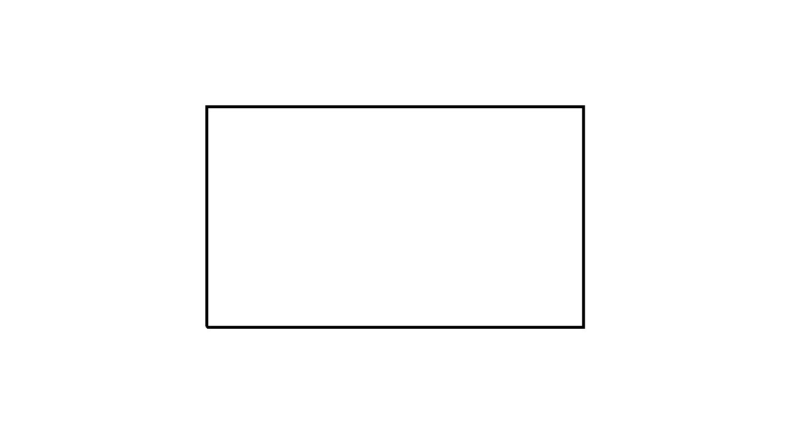
Basic Canvas draw
<canvas id="myCanvas" width="200"
height="100"
style="border:1px solid #000000;"> </canvas>
//A canvas is a rectangular area on an HTML page. By default, a canvas has no border and no content.

Slide 7
Draw Simple Canvas-using innerWidth and innerHeight
<canvas id="myCanvas" style="border:1px solid #d3d3d3;"></canvas>
<script>
var c = document.getElementById("myCanvas");
var ctx = c.getContext("2d");
c.width=window.innerWidth;
c.height=window.innerHeight;
</script>
//It will come with by default 8px margin on browser’s window. We can remove it by writing in body style attribute as ‘margin:0px;’

Slide 8
Draw Simple Canvas(Cont.)
InnerWidth & innerHeight:
The innerWidth property returns the inner width of a window's content area.
The innerHeight property returns the inner height of a window's content area.
(NOT including toolbars/scrollbars)
Tip: Use the outerWidth and outerHeight properties to get the width/height with toolbars/scrollbars.
innerWidth: 668
innerHeight: 513
outerWidth: 1366
outerHeight: 728

Slide 9
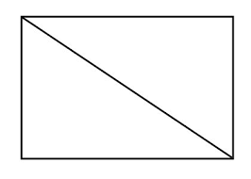
Draw a Line
<script>
var c = document.getElementById("myCanvas"); var ctx = c.getContext("2d"); ctx.moveTo(0, 0); ctx.lineTo(200, 100); ctx.stroke();
</script>

Slide 10
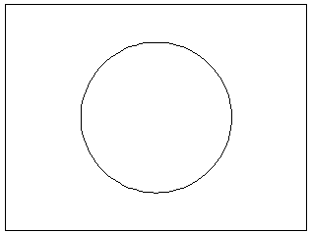
Draw a Circle
<script>
var c = document.getElementById("myCanvas"); var ctx = c.getContext("2d"); ctx.beginPath(); ctx.arc(95, 50, 40, 0, 2 * Math.PI); ctx.stroke();
</script>

Slide 11
Properties & Methods

Slide 12
moveTo( )-Method
The moveTo() method moves the path to the specified point in the canvas, without creating a line.
context.moveTo(x,y);
x x-coordinate of where to move the path to
y y-coordinate of where to move the path to
e.g
ctx.moveTo(0,0);
ctx.moveTo(50,20);

Slide 13
lineTo( )-Method
The lineTo() method adds a new point and creates a line TO that point FROM the last specified point in the canvas (this method does not draw the line).
context.lineTo(x,y);
x x-coordinate of where to create the line to
y y-coordinate of where to create the line to
e.g
ctx.lineTo(20,100); ctx.lineTo(70,100);

Slide 14
stroke( )-Method
The stroke() method actually draws the path you have defined with all those moveTo() and lineTo() methods. The default color is black.
context.stroke();
Tip: Use the strokeStyle property to draw with another color/gradient.

Slide 15
strokeStyle ( ) Method
The strokeStyle property sets or returns the color, gradient, or pattern used for strokes.
Default Value: #000000 (Black)
JS Syntax: context.strokeStyle=color|gradient|pattern;
Color: A CSS color value that indicates the stroke color of the drawing. Default value is #000000
Gradient: A gradient object (linear or radial) used to create a gradient stroke
Pattern: A pattern object used to create a pattern stroke

Slide 16

Draw a rectangle. Use a gradient stroke:
<script>
var c = document.getElementById("myCanvas");
var ctx = c.getContext("2d");
var gradient = ctx.createLinearGradient(0, 0, 170, 0);
gradient.addColorStop("0", "magenta");
gradient.addColorStop("0.5", "blue");
gradient.addColorStop("1.0", "red");
// Fill with gradient
ctx.strokeStyle = gradient;
ctx.lineWidth = 5;
ctx.strokeRect(20, 20, 150, 100);
</script>

Slide 17
fillStyle Property
The strokeStyle property sets or returns the color, gradient, or pattern used for strokes.
Default Value: #000000 (Black)
JS Syntax: context.strokeStyle=color|gradient|pattern;
i.e var c=document.getElementById("myCanvas"); var ctx=c.getContext("2d"); ctx.fillStyle="#FF0000"; ctx.fillRect(20,20,150,100);

Slide 18
addColorStop() Method
The addColorStop() method specifies the colors and position in a gradient object.
The addColorStop() method is used together with createLinearGradient() or createRadialGradient().
Note: You can call the addColorStop() method multiple times to change a gradient. If you omit this method for gradient objects, the gradient will not be visible. You need to create at least one color stop to have a visible gradient.

Slide 19
addColorStop() Method (Cont.)
JS Syntax: gradient.addColorStop(stop,color);
Stop: A value between 0.0 and 1.0 that represents the position between start and end in a gradient
i.e var c=document.getElementById('myCanvas'); var ctx=c.getContext('2d'); var grd=ctx.createLinearGradient(0,0,170,0); grd.addColorStop(0,"black"); grd.addColorStop(1,"white"); ctx.fillStyle=grd; ctx.fillRect(20,20,150,100);

Slide 20
fillRect() method
The fillRect() method draws a "filled" rectangle. The default color of the fill is black.
Tip: Use the fillStyle property to set a color, gradient, or pattern used to fill the drawing.
context.fillRect(x,y,width,height);

Slide 21
fillText() Method
The fillText() method draws filled text on the canvas. The default color of the text is black.
Tip: Use the font property to specify font and font size, and use the fillStyle property to render the text in another color/gradient.
context.fillText(text,x,y,maxWidth);

Slide 22
createRadialGradient() Method
The createRadialGradient() method creates a radial/circular gradient object.
The gradient can be used to fill rectangles, circles, lines, text, etc.
Tip: Use this object as the value to the strokeStyle or fillStyle properties.
Tip: Use the addColorStop() method to specify different colors, and where to position the colors in the gradient object.
context.createRadialGradient(x0,y0,r0,x1,y1,r1);

Slide 23
createLinearGradient() Method
The createLinearGradient() method creates a linear gradient object.
The gradient can be used to fill rectangles, circles, lines, text, etc.
Tip: Use this object as the value to the strokeStyle or fillStyle properties.
Tip: Use the addColorStop() method to specify different colors, and where to position the colors in the gradient object.
context.createRadialGradient(x0,y0,x1,y1);

Slide 24
arc() Method
The arc() method creates an arc/curve (used to create circles, or parts of circles).
Tip: To create a circle with arc(): Set start angle to 0 and end angle to 2*Math.PI.
Tip: Use the stroke() or the fill() method to actually draw the arc on the canvas.
Center: arc(100,75,50,0*Math.PI,1.5*Math.PI)
Start angle: arc(100,75,50,0,1.5*Math.PI)
End angle: arc(100,75,50,0*Math.PI,1.5*Math.PI)

Slide 25
arc() Method (Cont.)
context.arc(x,y,r,sAngle,eAngle,counterclockwise);
sAngle: The starting angle, in radians (0 is at the 3 o'clock position of the arc circle)
e.Angle: The ending angle, in radians
Counterclockwise: Optional. Specifies whether the drawing should be counterclockwise or clockwise. False is default, and indicates clockwise, while true indicates counter-clockwise.

Slide 26
setInterval() Method
The setInterval() method calls a function or evaluates an expression at specified intervals (in milliseconds).
The setInterval() method will continue calling the function until clearInterval() is called, or the window is closed.
The ID value returned by setInterval() is used as the parameter for the clearInterval() method.
Tip: 1000 ms = 1 second.
Tip: To execute a function only once, after a specified number of milliseconds, use the setTimeout() method.

Slide 27
References:
https://www.w3schools.com/html/html5_canvas.asp
https://www.w3schools.com/TAGs/ref_canvas.asp
https://www.html5canvastutorials.com/
https://www.youtube.com/playlist?list=PLpPnRKq7eNW3We9VdCfx9fprhqXHwTPXL
http://techfunda.com/
Tools:
For Video Record – ISpring
For Code – Notepad++

